Slide 1

Week 1 – Home Learning
Year 4.

Slide 2
Website Links:
https://classroom.thenational.academy
https://www.onceuponapicture.co.uk
https://www.bbc.co.uk/bitesize/levels/zbr9wmn
https://www.purplemash.com/partington
https://ttrockstars.com/

Slide 3
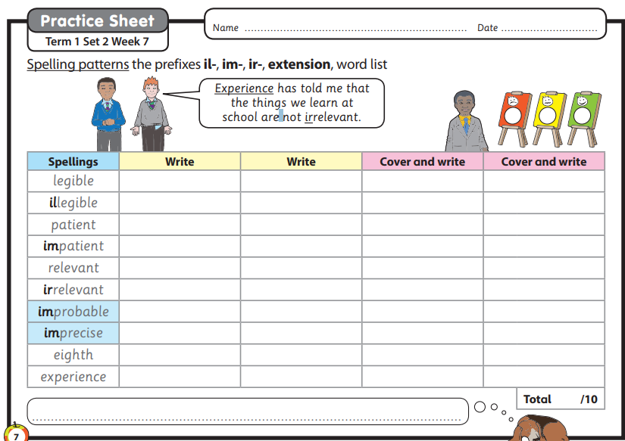
Wednesday - Spelling
Here are your spellings for this week.
Read them out loud to yourself. Think about their meaning.
If you are unsure ask a grown-up to help you.
Cover them up one by one and try to write them down correctly.
Look at them to check they are correct or ask a grown up to check them for you.

Slide 4

Wednesday – Guided Reading
Lesson 1
Write all work into your workbook or on a piece of paper.
Copy and paste the website link into internet browser to access
https://classroom.thenational.academy/lessons/to-engage-with-the-text-cnhkcd

Slide 5
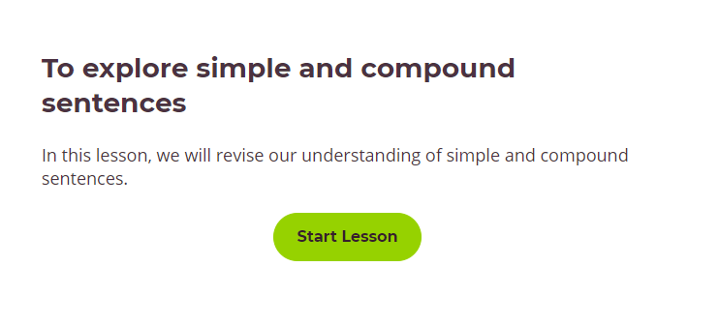
Wednesday – English
Lesson 1
Write all work into your workbook or on a piece of paper.
Copy and paste the website link into internet browser to access
https://classroom.thenational.academy/lessons/to-explore-simple-and-compound-sentences-6hk3ed

Slide 6
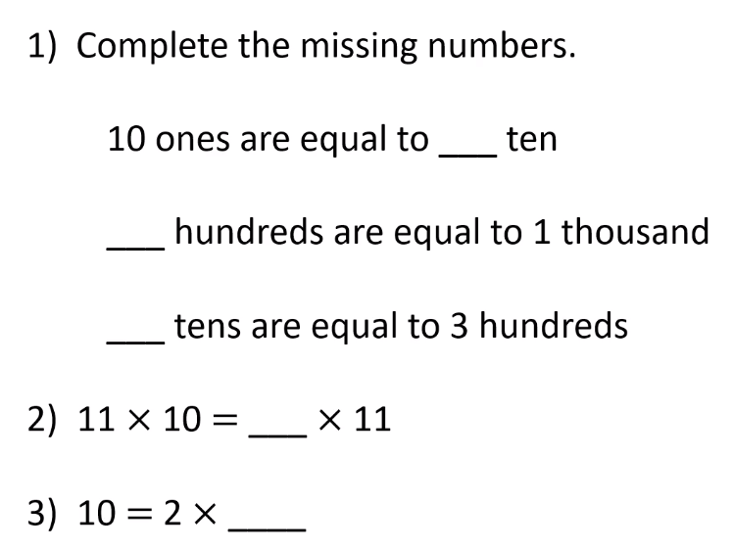
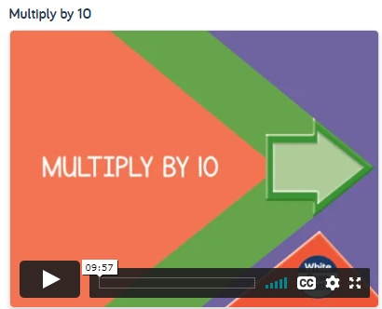
Wednesday – Maths
L- To multiply by 10
Warm up
Click on the link below to access the learning for today
https://whiterosemaths.com/homelearning/year-4/week-10-number-multiplication-division/

Slide 7
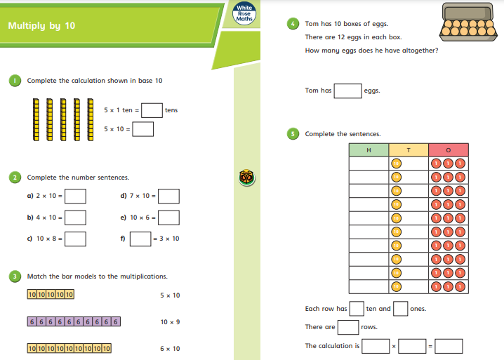
Wednesday – Maths
L- To multiply by 10
After you have watched the video have a go at the questions on the worksheet. Answer in your books.

Slide 8
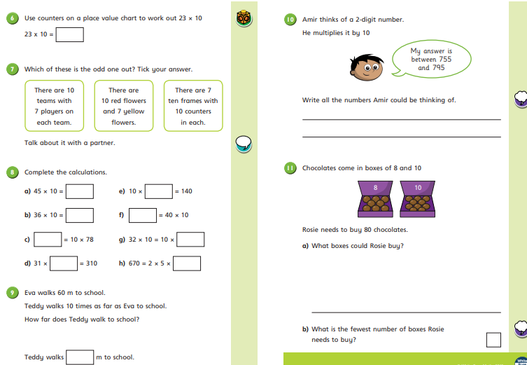
Wednesday – Maths
L- To multiply by 10
After you have watched the video have a go at the questions on the worksheet.
Answer in your books..
Questions 10 and 11 are trickier. Are you brave enough to try them?

Slide 9
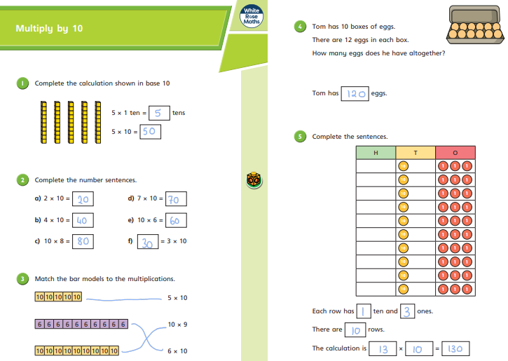
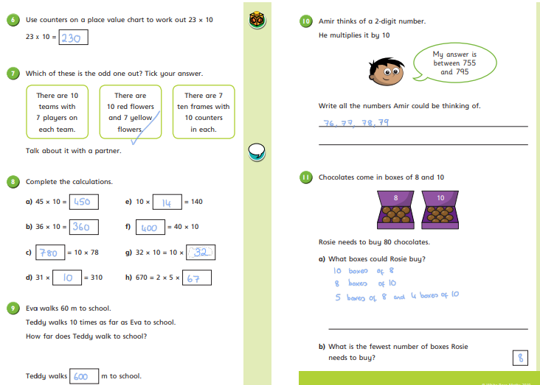
Wednesday – Maths
L- To multiply by 10
Mark your work. How did you do?
Make sure you check your corrections.
Can you work out where you went wrong?

Slide 10
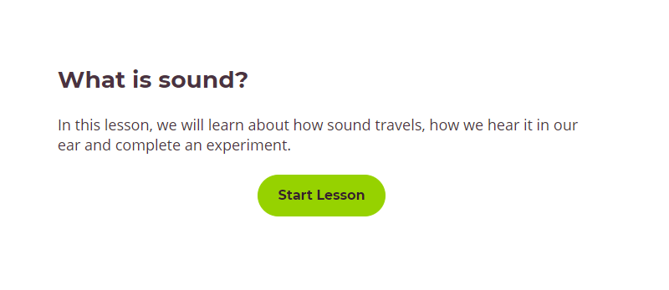
Wednesday – Science
If you try the experiment send me a picture.
Click on this link:
https://classroom.thenational.academy/lessons/what-is-sound-chh30r

Slide 11

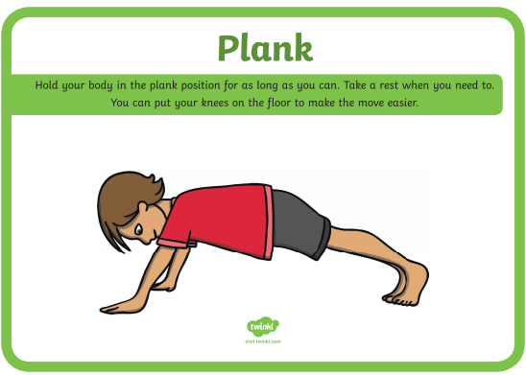

Wednesday – PE
Have you got someone you can challenge?
Have a plank off!!!!

Slide 12
Thursday

Slide 13
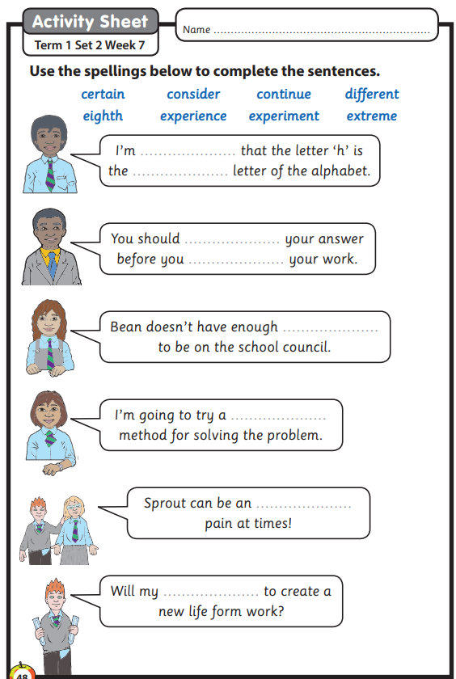
Thursday – Spelling
Copy and complete the sentences from the worksheet onto paper.

Slide 14
Thursday – Guided Reading
Lesson 2
Write all work into your workbook or on a piece of paper.
Copy and paste the website link into internet browser to access
https://classroom.thenational.academy/lessons/to-analyse-a-character-bradley-cgvk8c

Slide 15
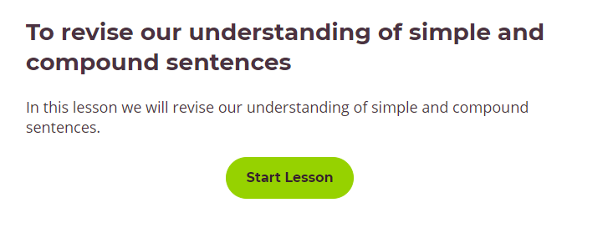
Thursday – English
Lesson 2
Write all work into your workbook or on a piece of paper.
Copy and paste the website link into internet browser to access
https://classroom.thenational.academy/lessons/to-revise-our-understanding-of-simple-and-compound-sentences-65gkje

Slide 16
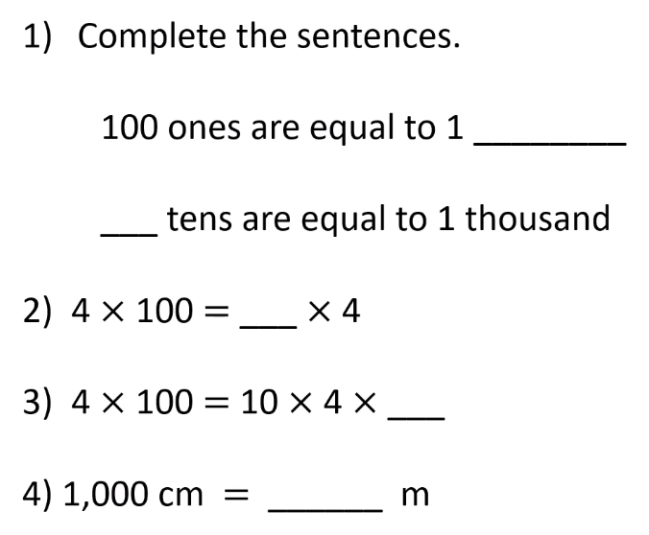
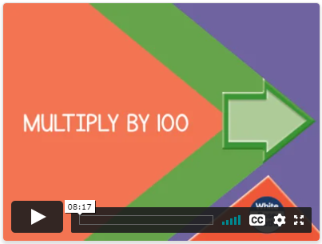
Thursday – Maths
L- To multiply by 100
Warm up
Click on the link below to access the learning for today
https://whiterosemaths.com/homelearning/year-4/week-10-number-multiplication-division/

Slide 17
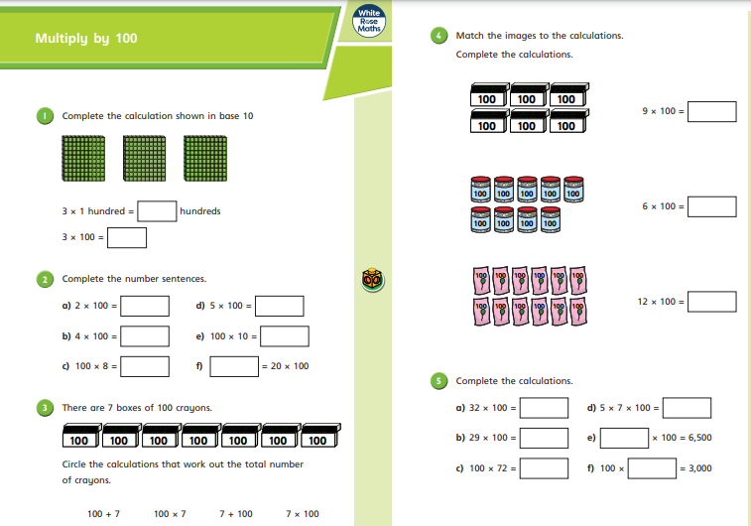
Thursday – Maths
L- To multiply by 100
After you have watched the video have a go at the questions on the worksheet. Answer in your books.

Slide 18
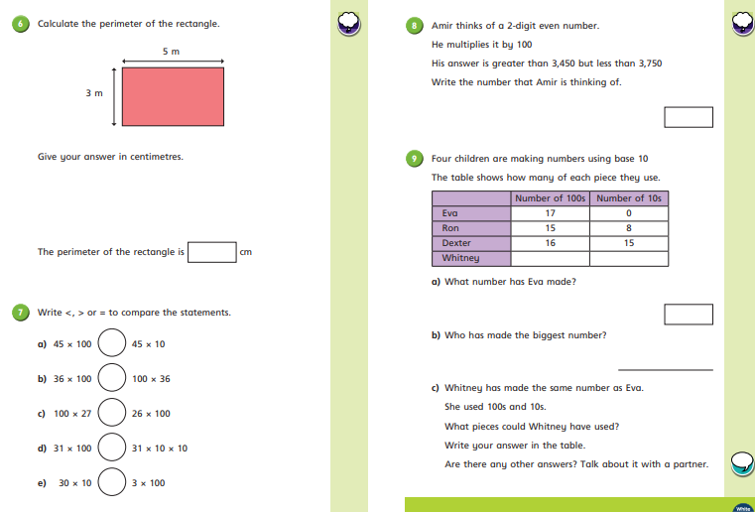
Thursday – Maths
L- To multiply by 100
After you have watched the video have a go at the questions on the worksheet. Answer in your books.

Slide 19
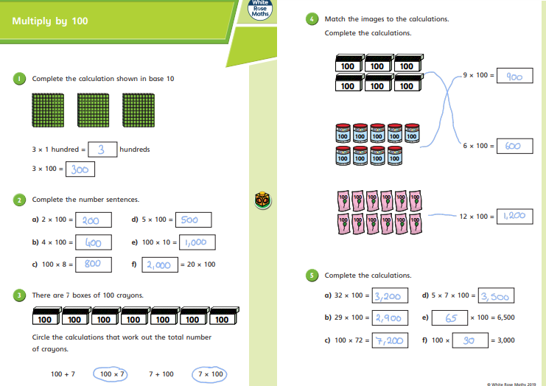
Thursday – Maths
L- To multiply by 100
Mark your work. How did you do?
Make sure you check your corrections.
Can you work out where you went wrong?

Slide 20

Thursday – Maths
L- To multiply by 100
Mark your work. How did you do?
Make sure you check your corrections.
Can you work out where you went wrong?
If you had a wobble access this link to further support your learning.
https://www.youtube.com/watch?v=7Y0zSnhiShc

Slide 21
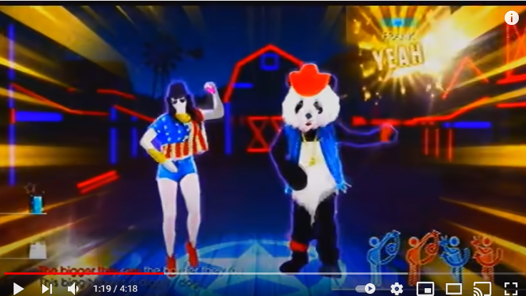
Thursday – PE
Let’s have a dance!!!
https://www.youtube.com/watch?v=lQxj2JcHEso
Who will you follow?
Can you convince someone to do it with you?
Lets see a picture of your best moves.

Slide 22
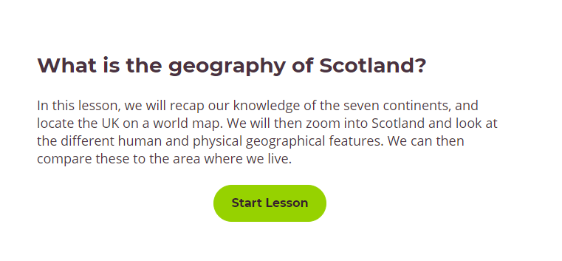
Thursday – Geography
Click on this link
https://classroom.thenational.academy/lessons/what-is-the-geography-of-scotland-70vk4t
Have you ever been to Scotland?
It’s one of my favourite places!

Slide 23
Friday

Slide 24
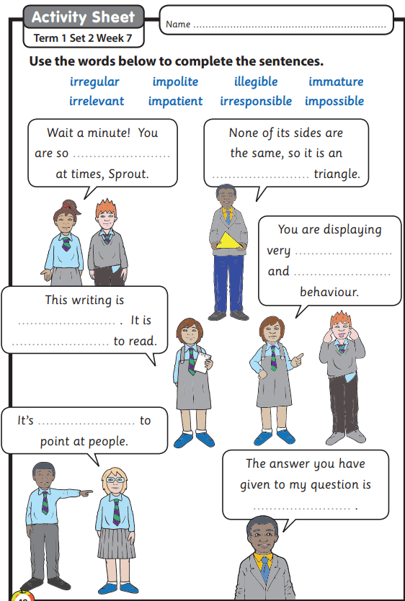
Friday – Spelling
Copy and complete the sentences from the worksheet onto paper ☺

Slide 25
Friday – Guided Reading
Lesson 3
Write all work into your workbook or on a piece of paper.
Copy and paste the website link into internet browser to access
https://classroom.thenational.academy/lessons/to-analyse-a-character-jeff-c9k6cd

Slide 26
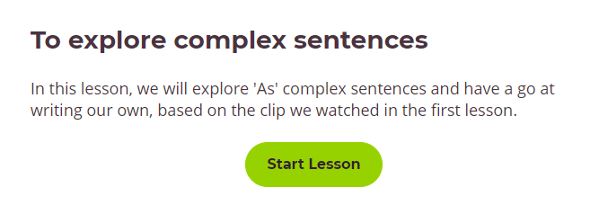
Friday – English
Lesson 3
Write all work into your workbook or on a piece of paper.
Copy and paste the website link into internet browser to access
https://classroom.thenational.academy/lessons/to-explore-complex-sentences-68wp8c

Slide 27
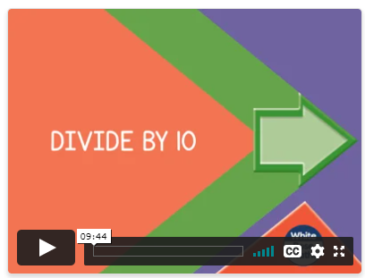
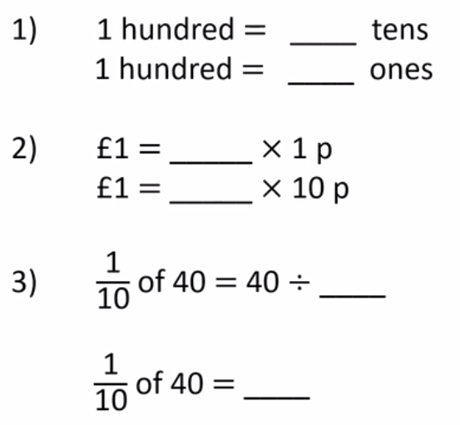
Maths Friday
L- To divide by 10
Warm up
Click on the link below to access the learning for today
https://whiterosemaths.com/homelearning/year-4/week-10-number-multiplication-division/

Slide 28
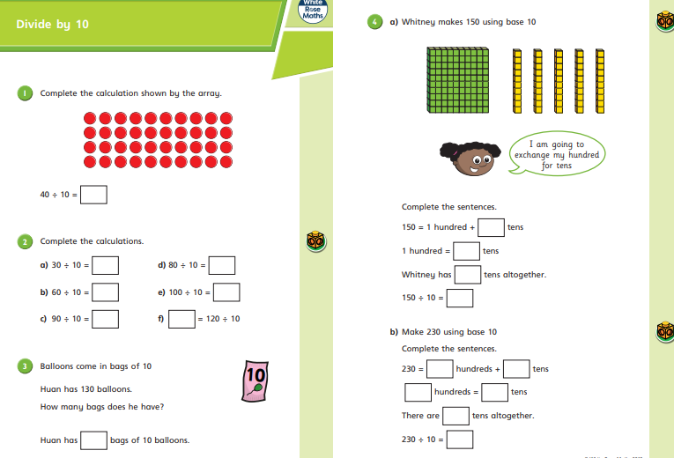
Maths Friday
L- To divide by 10
After you have watched the video have a go at the questions on the worksheet. Answer in your books.

Slide 29
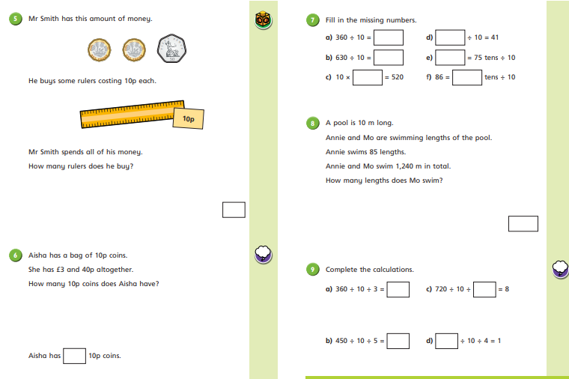
Maths Friday
L- To divide by 10
After you have watched the video have a go at the questions on the worksheet. Answer in your books.
Question 9 will really get you thinking.

Slide 30
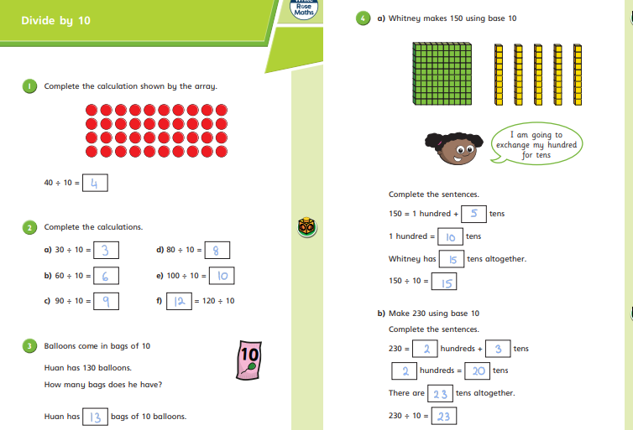
Maths Friday
L- To divide by 10
Mark your work. How did you do?
Make sure you check your corrections.
Can you work out where you went wrong?

Slide 31
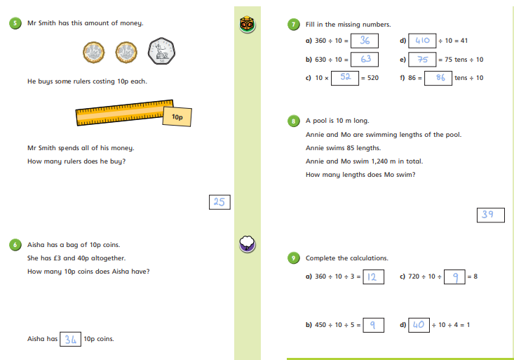
Maths Friday
L- To divide by 10
Mark your work. How did you do?
Make sure you check your corrections.
Can you work out where you went wrong?

Slide 32

Y3-4 home learning:
Expressing feelings

Slide 33



      We are learning about expressing feelings
      We will be able to:
  name a range of feelings and emotions
  match feelings to a scale of intensity and identify strong feelings
  describe different feelings and how they are experienced in the body
  recognise why it is important for people to express their feelings

Slide 34



Expressing feelings:
What’s our starting point?
Make a ‘feelings’ graffiti board.
On a piece of paper, jot down all of the words you can think of to describe feelings and emotions.

Slide 35
Feelings thermometers
Read the words from the Feelings match up sheet (on the next slide)
overjoyed
Find the root words first.
Now match the similar feelings words together
Then organise them in order of intensity
  Which is the biggest feeling?
Write it down on a piece of paper like this example.
delighted
satisfied
pleased
Pleased is the root word and overjoyed is the biggest, strongest or most intense feeling.

Slide 36
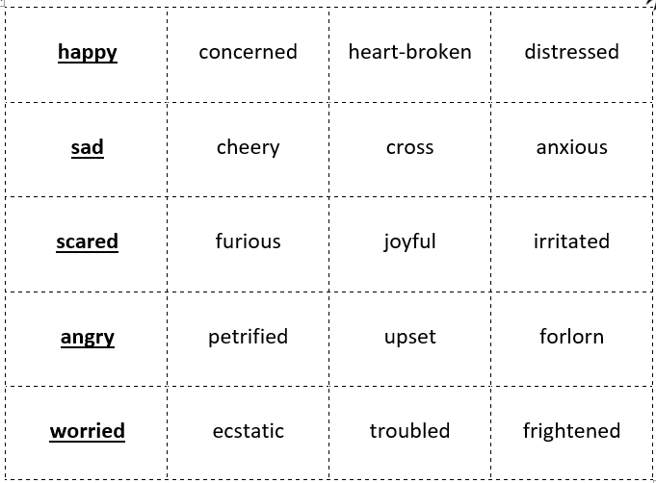
Friday

Slide 37


Expressing feelings
Choose one of the words that describes a ‘big’ feeling from your lists.
Now draw a body outline and draw or write on it.
Where in the body might someone have that feeling?
If the feeling had a colour, what would it be?
If it had a shape, what would it be?
If it had a texture, what would it be?
If the feeling had a sound, what would it be?
If the feeling were an image or a picture, what would it be?

Slide 38




Feelings imagery
Thinking of images can help us describe strong or intense feelings.
What feelings do these images make you think of?

Slide 39



Writing about feelings
Write a sentence to match each picture and describe the feeling you think it best represents.
For example: Like a little cat, outside and lost in a snowstorm, she felt lonely and afraid.

Slide 40

Why is it important to express feelings?
Expressing our different feelings helps us to recognise and manage them.
Expressing feelings can help stop strong or intense feelings from taking over our minds and bodies.
It helps us recognise when we might need help with our feelings.
Sometimes it is good for others to know how we are feeling — it helps them to help us.

Slide 41







Ways to express feelings
What are some of the different ways people can express their feelings?
art – drawing, painting, collage
talking to others
writing – diaries, poems, stories, blogs
face and body
music
acting, dancing and singing

Slide 42

Remember!
Expressing our feelings is important — it helps our minds stay well. There are many ways you can do this but talking to an adult you trust is one of the best ways.
If you are worried about any feeling, always talk to a trusted adult about it.
Talk to a trusted adult at home or at school
If you want to talk to someone other than a parent or teacher, ChildLine can help. See:
https://www.childline.org.uk/get-support/ or phone 0800 1111
ChildLine: www.childline.org.uk
0800 1111

Slide 43


Expressing feelings:
Where are you now?
Go back to the ‘graffiti board?’ activity you did at the start.
Have you learned any new words or ways to describe feelings and emotions?
Add them to your graffiti board using a different coloured pen or pencil.

Slide 44

Additional activity
Produce a piece of artwork (a painting or collage) or descriptive writing (a poem or the beginning of a story) about feelings.

Slide 45
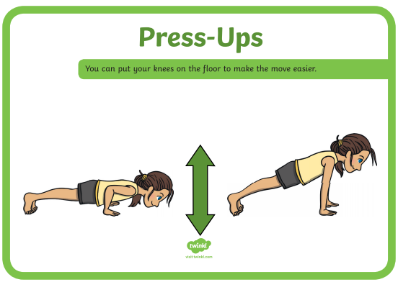
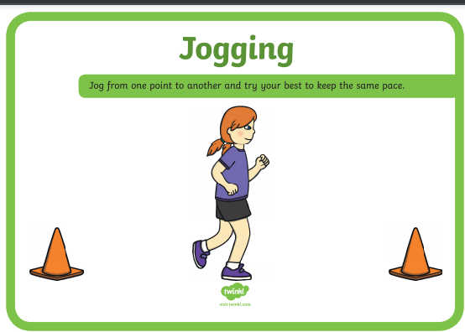
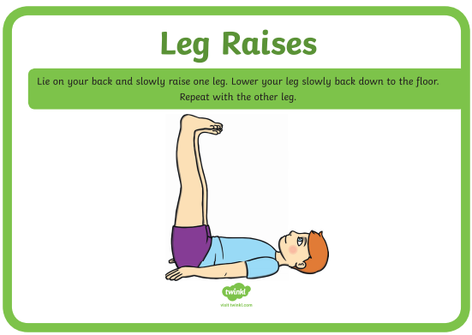
Friday - PE

