Slide 1
Week 1 – Home Learning You will need an exercise book or a pad of paper to record your learning.

Slide 2
Wednesday

Slide 3
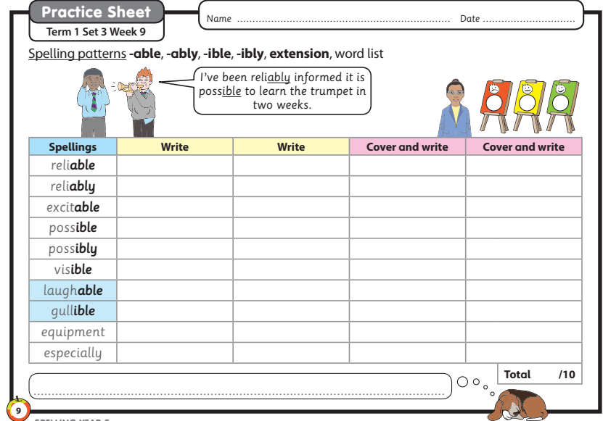
Write out each spelling twice by carefully copying. Now can you write out your spelling without looking at it?☺
Wednesday – Spelling

Slide 4
Wednesday – Guided Reading
Lesson 1
L- To engage with the text.
Follow the steps and learning set out in the video link below.
Copy and paste the website link into internet browser to access
https://classroom.thenational.academy/lessons/to-engage-with-the-text-6mu32d?activity=video&step=1

Slide 5
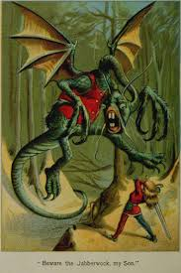
Wednesday – English
Lesson 1
L- To engage with the poem The Jabberwocky.
Write all work into your workbook or on a piece of paper or alternatively record onto Purple Mash.
Copy and paste the website link into internet browser to access
https://classroom.thenational.academy/lessons/to-engage-with-the-poem-71h66r

Slide 6
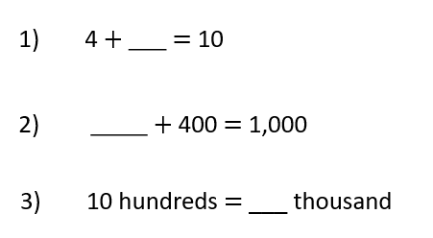
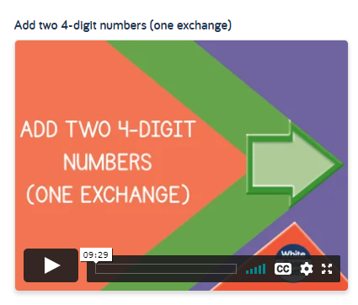
Maths Wednesday
L- To add two 4-digit numbers with one exchange
Warm up
Click on the link below to access the learning for today
Week 4 - Number: Addition & Subtraction | White Rose Maths

Slide 7
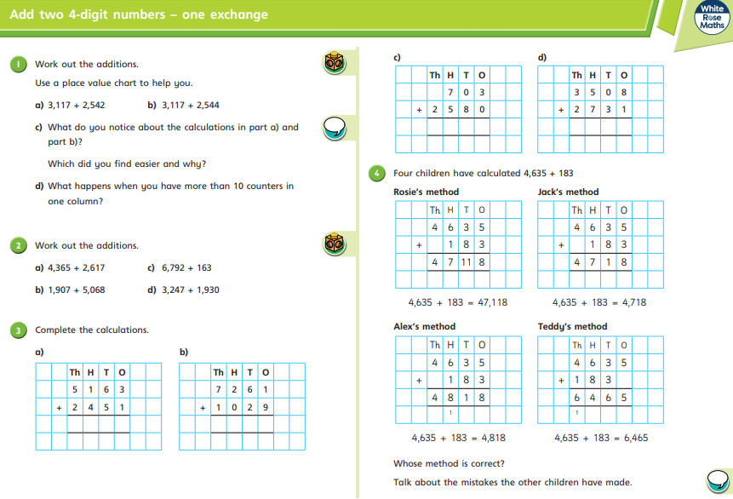
Maths Wednesday
L- To add two 4-digit numbers with one exchange
After you have watched the video have a go at the questions on the worksheet.
Answer in your books or on a piece of paper.
Take care with your place value!

Slide 8
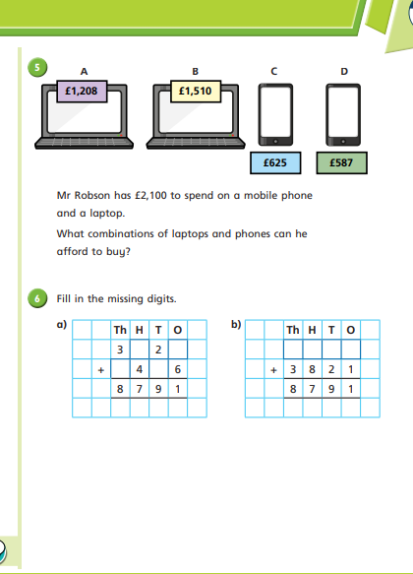
Maths Wednesday
L- To add two 4-digit numbers with one exchange
After you have watched the video have a go at the questions on the worksheet.
Answer in your books or on a piece of paper.
Top tip: Read the question twice! What is the key information?

Slide 9
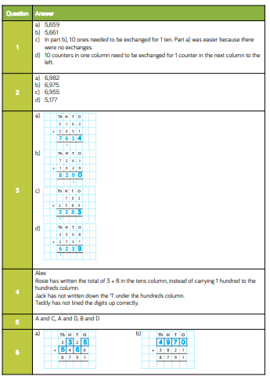
Maths Wednesday
L- To add two 4-digit numbers with one exchange
Mark your work. How did you do?
Make sure you check your corrections.
Can you work out where you went wrong?
Can you explain how you make an exchange?
If you had a wobble access this link to further support your learning.
https://www.bbc.co.uk/bitesize/topics/zy2mn39/articles/z3kmrwx

Slide 10
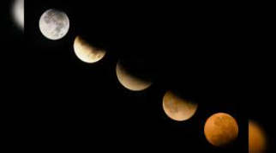
Wednesday – Science
Lesson 1
L-What are solar and lunar eclipses?
Write all work into your workbook or on a piece of paper or alternatively record onto Purple Mash account.
Copy and paste the website link into internet browser to access
https://classroom.thenational.academy/lessons/what-are-solar-and-lunar-eclipses-6nh3et?step=1&activity=video

Slide 11
Wednesday – PE
L-To create a Space dance.
Can you video your dance?
Copy and paste the website link into internet browser to access this suggested music clip.
https://www.youtube.com/watch?v=IFPwm0e_K98
Lesson link:
Space Adventure - YouTube

Slide 12
Thursday

Slide 13
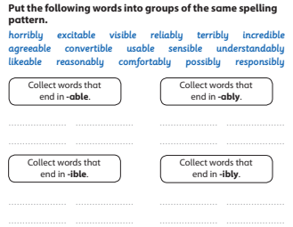
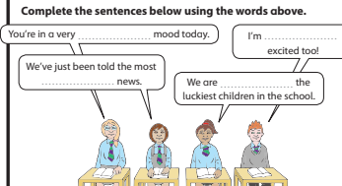
Thursday – Spelling
Write down your answers into an exercise book or onto paper. Remember to write today’s date.

Slide 14
Thursday – Guided Reading
Lesson 2
L- To answer questions on the text.
Follow the steps and learning set out in the video link below answer questions into an exercise book or on paper.
Copy and paste the website link into internet browser to access
https://classroom.thenational.academy/lessons/to-answer-questions-on-the-text-part-1-ccrp2d?activity=video&step=1

Slide 15
Thursday – English
Lesson 2
L- To explore the French derived sounds in The Jabberwocky.
Follow the video step by step. Write all work into your workbook or on a piece of paper. Alternatively type up and save in your Purple Mash account
Copy and paste the website link into internet browser to access:
https://classroom.thenational.academy/lessons/to-investigate-french-derived-sounds-ccu3ed

Slide 16
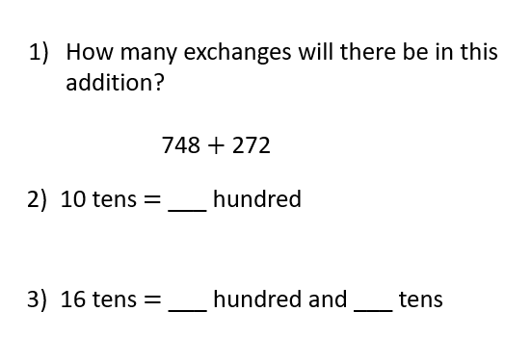
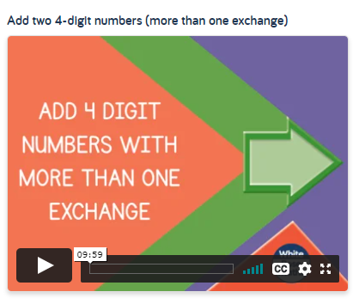
Maths Thursday
L- To add two 4-digit numbers with more than one exchange
Warm up
Click on the link below to access the learning for today
Week 4 - Number: Addition & Subtraction | White Rose Maths

Slide 17
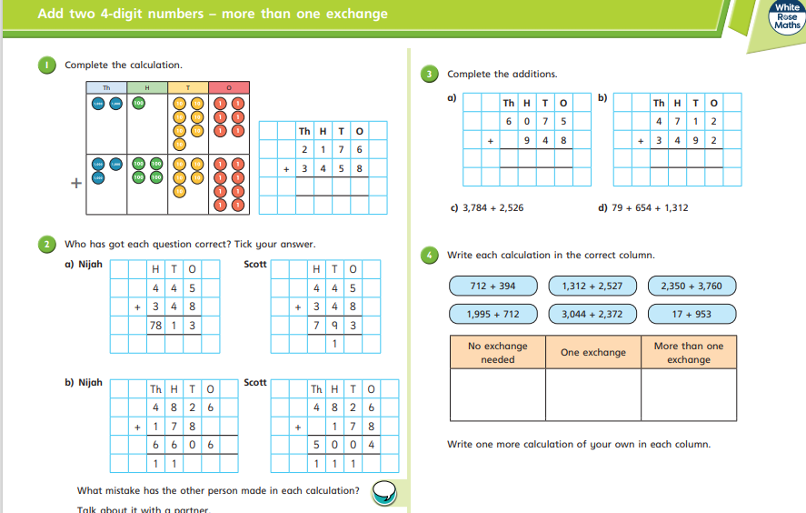
Maths Thursday
L- To add two 4-digit numbers with more than one exchange
After you have watched the video have a go at the questions on the worksheet. Answer in your books or on a piece of paper.

Slide 18
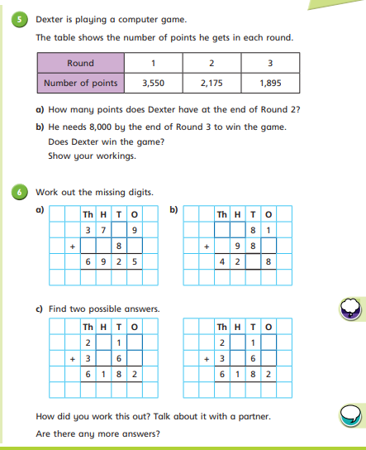
Maths Thursday
L- To add two 4-digit numbers with more than one exchange
After you have watched the video have a go at the questions on the worksheet. Answer in your books or on a piece of paper.
Can you explain how you have worked this out?

Slide 19
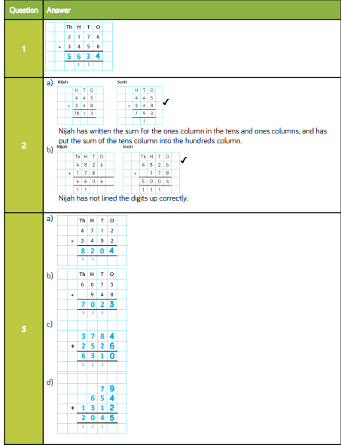
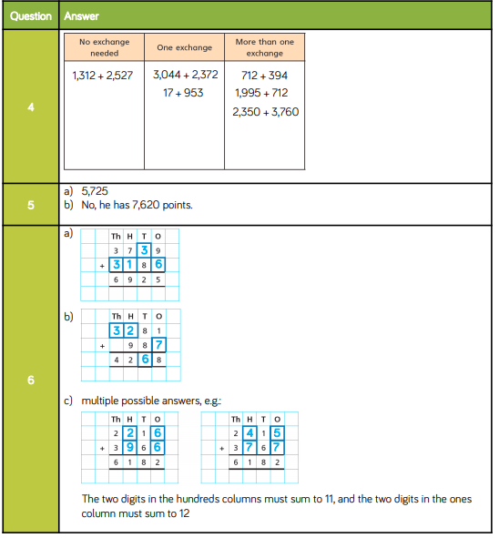
Maths Thursday
L- To add two 4-digit numbers with more than one exchange
Mark your work. How did you do?
Make sure you check your corrections.
Can you work out where you went wrong?
Can you explain when and why you need to make more than one exchange?
If you had a wobble access this link to further support your learning.
https://www.bbc.co.uk/bitesize/topics/zy2mn39/articles/z3kmrwx

Slide 20
Thursday – Topic - Geography
L- What are the countries of Europe?
Follow the video step by step. Write all work into your workbook or on a piece of paper. Alternatively type up and save in your Purple Mash account.
Complete the fun quiz after the video. Let me know your score.
Copy and paste the website link into internet browser to access the lesson
https://classroom.thenational.academy/lessons/what-are-the-countries-of-europe-69k6cr?activity=video&step=1

Slide 21
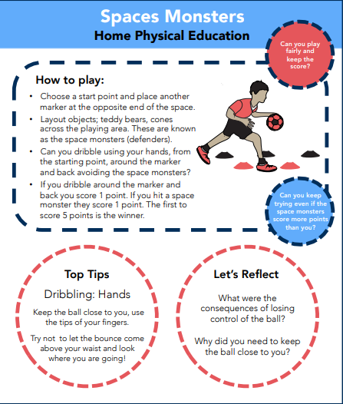
Thursday – PE
L-To dribble around objects
Can you keep your score?
Copy and paste the website link into internet browser to access this clip.
https://www.youtube.com/watch?v=Wj0RwCe2uxM

Slide 22
Friday

Slide 23
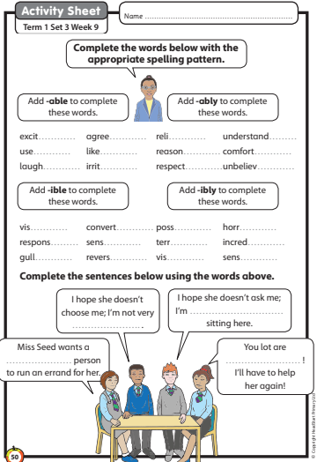
Friday – Spelling
Write down your answers into an exercise book or onto paper. Remember to write today’s date.

Slide 24
Friday – Guided Reading
Lesson 3
L- To analyse the characters
Follow the steps and learning set out in the video link below answer questions into an exercise book or on paper.
Copy and paste the website link into internet browser to access
https://classroom.thenational.academy/lessons/to-analyse-characters-cmu3gd?activity=video&step=1

Slide 25
Friday – English
Lesson 5
L-To explore the function of apostrophes.
Follow the video step by step. Write all work into your workbook or on a piece of paper. Alternatively type up and save in your Purple Mash account
Copy and paste the website link into internet browser to access
https://classroom.thenational.academy/lessons/to-explore-the-function-of-apostrophes-70up2d

Slide 26
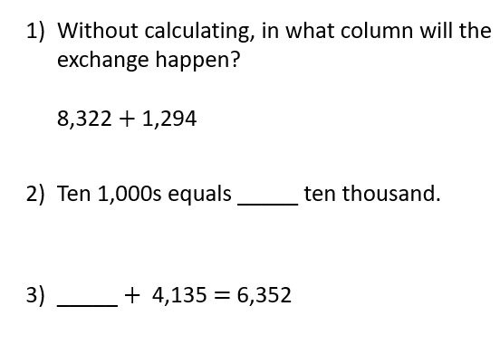
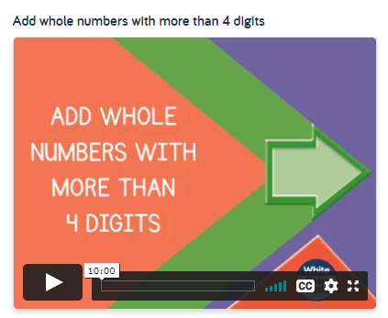
Maths Friday
L- To add whole numbers with more than 4 digits.
Warm up
Click on the link below to access the learning for today
Week 4 - Number: Addition & Subtraction | White Rose Maths

Slide 27
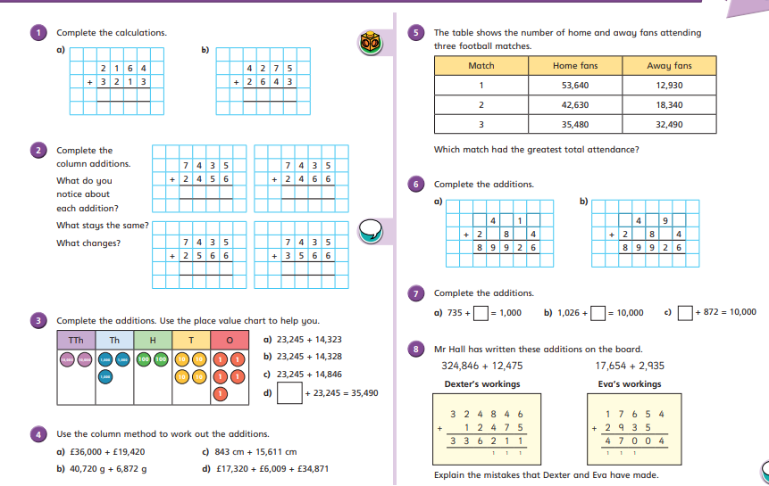
Maths Friday
L- To add whole numbers with more than 4 digits.
After you have watched the video have a go at the questions on the worksheet. Answer in your books or on a piece of paper.

Slide 28
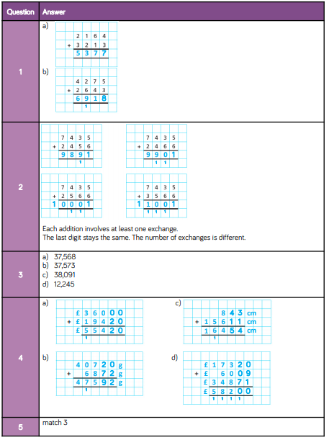
Maths Friday
L- To add whole numbers with more than 4 digits.
Mark your work. How did you do?
Make sure you check your corrections.

Slide 29
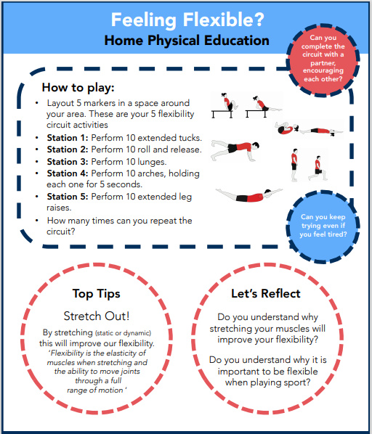
Friday – PE
L-To understand how stretching your muscles can keep you flexible.
Can you keep trying even if you feel tired?
Copy and paste the website link into internet browser to access this clip.
https://www.youtube.com/watch?v=J7ymsKEgKtw&list=PLnwoPgo24bhmqV8Y76iXnwYw9T9AlxbqJ&index=36&t=0s

Slide 30
Friday – PSHE
Mental health: keeping well and managing feelings
Carefully read through the following Power Point slides. Complete the task set on the last slide in your exercise book or on paper. Alternatively you can use Purple Mash to evidence your learning and save onto your account.

Slide 31
Friday – PSHE
We are learning about mental health; what it means and how we can take care of it
We will be able to:
explain what is meant by the term ‘mental health’
identify everyday behaviours that can help to support mental (and physical) health
recognise that we can take care of our mental health (as well as our physical health)

Slide 32
Friday – PSHE
Mental health and keeping well:
What’s our starting point?
Imagine someone, about your age (or a bit older than you) who lives near you and goes to a school like yours.
Draw and write about the things they can do to help look after their mental health.

Slide 33
Friday – PSHE
What is mental health?
Mental health means being happy all the time.
Read the statements about mental health.
Which do you feel best explains mental health? Have you got a different idea?
Mental health is about feelings and emotions; knowing how to take care of ourselves so that we can cope with things that happen to us.
Our mental health is about our feelings and emotions. People’s mental health can feel better or worse at different times, just like physical health. It is as important to take care of our mental health (minds) as our physical health (bodies).
Mental health means there is something wrong with a person and they might behave in a strange way.
Click on the box to reveal a possible answer
Mental health means that you often feel worried, anxious or depressed.
Mental health is a bit like a continuum – people can move along it and feel better or worse at different times, just like with physical health.

Slide 34
Friday – PSHE
Mental health definitions
There are different definitions of mental health but most agree that it is about our thoughts and feelings, and how we behave.
The World Health Organisation describes mental health as:
‘A state of wellbeing in which every individual realises his or her own potential, can cope with the normal stresses of life, can work productively and fruitfully, and is able to make a contribution to her or his community.’
NHS England describes mental health as:
‘How we think, feel and behave’.

Slide 35
Friday – PSHE
Thinking about mental health
Mental health can be thought of as a scale that can move up or down, a bit like a thermometer.
We can move along the scale at any time, between being healthy or unwell.
There are things we can do to help us stay healthy.
There are things that can be put in place if someone is not feeling so good, is struggling or unwell.

Slide 36
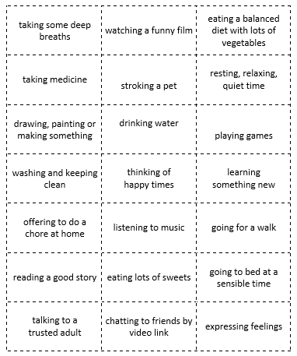
Friday – PSHE
Looking after ourselves –
Into your books mind map something you could do to help support mental health
Things someone could do everyday
Things someone might only do sometimes.
Things someone might do if there is a problem.
Things someone should do only rarely or not at all

