Slide 1
Partington Central Academy
Starting Reception
Information for Parents

Slide 2
Welcome
Welcome to Partington Central Academy.
At Partington Central Academy we aim to provide a happy, secure and stimulating environment with opportunities for children to learn and develop positive relationships with their peers and adults.
At Partington Central Academy we aim to work closely with parents and carers and create an effective home school partnership.

Slide 3
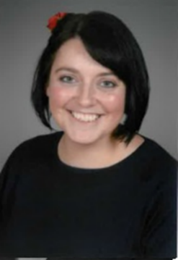
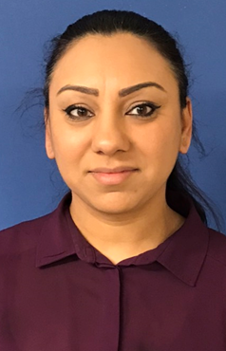
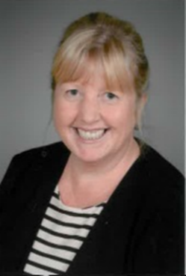
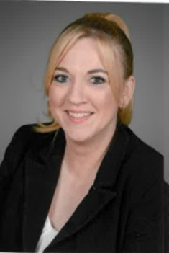
Reception Staff
Mrs Caswell Early Years Leader &
Reception Teacher
Mrs Kaur Reception Teacher
Mrs Holden
Reception TA
Mrs Pickens
Reception TA

Slide 4
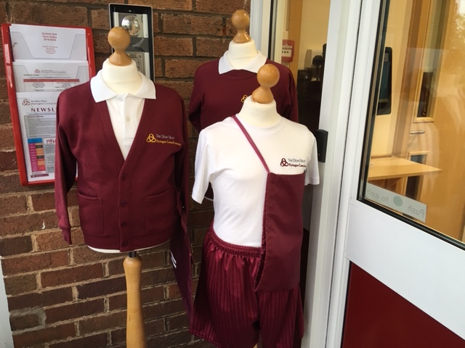
Uniform
We are proud of our school uniform and believe that it helps a child identify with the school and their peers.
School uniform is compulsory for all children from Nursery to Y6 and is available from the Petites Modes website (www.petitesmodessale.com) or their shop on Tatton Road in Sale.
All children must wear the correct uniform and P.E. kit.

Slide 5
Uniform
Girls’ Uniform Grey pinafore dress/skirt, grey trousers, white polo shirt and school badged sweatshirt/cardigan. A pink and white check summer dress is permitted in the summer months only.
Black school shoes must be worn by all pupils.
Make up or nail varnish are not permitted in school.
Jewellery is not permitted in school; if you intend to have your child’s ears pierced this must be done at the beginning of the summer break, this will allow time for the healing process so they can be removed once returning to school.
Boys’ Uniform
Grey trousers, white polo shirt and school badged sweatshirt.
Black school shoes must be worn by all pupils.
PE Kit
Whole school: White T-Shirt, Maroon PE shorts.
For outdoor games all children should have suitable footwear, i.e. pumps or trainers and in the winter months they can wear a pair of dark tracksuit bottoms
Hair
Extreme hair fashions, including dyed and ‘striped’ hair / patterned and extensions are not permitted. Hair should be no shorter than a No.3. Long hair should be tied back with a plain bobble. Bows are not permitted
PLEASE clearly name all items of clothing brought into school as this helps greatly when trying to identify “LOST PROPERTY.”

Slide 6
Curriculum
Reception is part of the Early Years Foundation Stage.
The Early Years Foundation Stage sets standards for the learning, development and care of children from birth to 5 years old. All schools and Ofsted-registered early years providers must follow the Early Years Foundation Stage and this includes childminders, preschools, nurseries and school reception classes.
The Early Years Foundation Stage framework supports an integrated approach to early learning and care. It gives all professionals a set of common principles and commitments to deliver quality early education and childcare experiences to all children.
The Early Years Foundation Stage is from beginning of Nursery to the end of Reception and has its own separate curriculum.
The curriculum is play based where the children investigate and explore with hands on and practical activities which promotes the children to become and continue to be independent learners.

Slide 7
Curriculum
There are 7 areas of learning in the Early Years Foundation Stage Curriculum and all the teaching we do relates to these areas.
There are 3 Prime areas of learning - Communication & Language; Personal, Social and Emotional Development; and Physical Development.
There are 4 Specific areas of learning –Literacy; Maths; Knowledge of the World; and Expressive Arts and Design.
Within each of these 7 areas there are statements of learning which all lead into a final statement called the Early Learning Goal which all the children work towards. The aim is that the majority of children will have reached this level by the end of Reception.

Slide 8
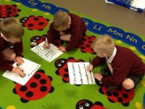
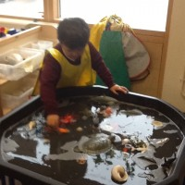
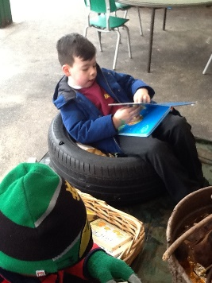
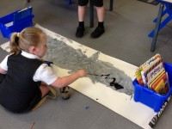
The Reception Setting
Children will take part in a mixture of whole class activities, group activities and individual activities.
Within the setting there are many areas such as the writing, reading, creative, construction, playdough, role play, small world, sand, water, and maths areas.
These areas are fully equipped and enhanced to engage and stimulate the children.

Slide 9
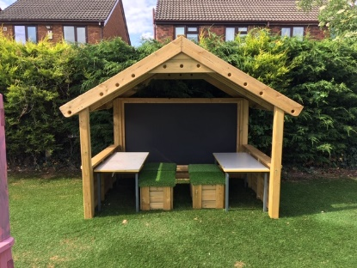
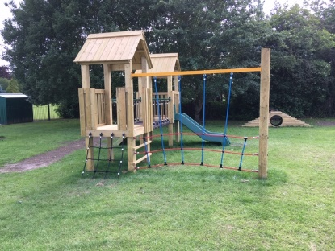
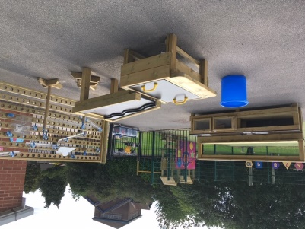
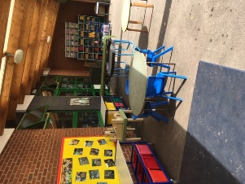
The Reception Setting
The children also have access to a newly developed outdoor area . Children go outside every day come rain or shine so we do ask that your child wears suitable school shoes and always brings a coat.
It would also be beneficial if every child could bring a change of clothes with them to school which they keep on their coat peg for any accidents that they may have.

Slide 10
Lunchtime
Children staying at school can either have a school dinner or a packed lunch.
School Dinners
Dinners are eaten in the school canteen supervised by lunchtime supervisors and a member of the Reception team. A variety of nutritional dishes are served and children are presented with several different options every day. Due to Covid-19 and our special arrangements to prevent children mixing with different bubbles, children will be given ‘packed lunch’ style meals initially. This will change as restrictions lift and will be reviewed when we return in Sept.
All children from Reception to Year 2 have the option of a free school dinner.
Packed Lunches
Children may bring a packed lunch to school. Please ensure that this lunch is put into a named bag or container.
We have a healthy eating policy. Children are not allowed to bring fizzy drinks, sweets, chocolate bars or energy drinks. Small cakes or chocolate biscuits will be acceptable.
We are also a nut free school so no products and spreads containing nuts are permitted.

Slide 11
Behaviour
My name will go in the Golden Book. I will get a note home to celebrate. 3 or more Golds in a Term= A Golden Reward | Gold | I am working well within a team. I am being kind to others. I am working extra hard and demonstrating our school values.
I will get a note home to celebrate. | Silver | I am thinking of others. I am playing well outside and inside the classroom. I am showing my manners. I am working hard at home.
I will get a sticker or class dojo. | Bronze | I am trying really hard. I am completing tasks. I am following the class rules.
All children start each day on white. | White | I am ready to learn.
I will get a verbal warning and be reminded of our rules. | Green | I am stopping my friends from learning.
I will miss 5 minutes of my playtime. | Amber | I have not followed instructions. I have not told the truth. I have been rude to an adult.
My name will be recorded in the back of the behaviour book. My teacher will speak to my parent or carer. 1 red- I will be sent to a Member of SLT for my phase. 2 Reds- I will work with a member of SLT for my phase. | Red | I have refused an adult. I have used ‘naughty’ words. I have hurt my friends on purpose.

Slide 12
How to Prepare your Child for School.
On starting school, it would be helpful if you could encourage and support your child to learn how to complete the following.
1) Put on and take off their own coat.
2) Go to the toilet, wipe themselves and wash their hands.
3) Eat with a knife, fork and spoon.
4) Dress and undress
5) Be aware of how to turn their clothes the correct way around once undressed.
6) Take care of toys and equipment around them
7) Share and take turns.
8) Share and read books with your child
Children must be toilet trained.

Slide 13
Finally…
Please talk to us. No problem is too big or too small, we are here to reassure you and answer any questions that you may have.
Please make sure you fill out the forms within your pack and hand them back to one of the Reception team.

Slide 14
Concerns….We’re here to help!
Useful contacts:
Miss. A. Edwards (Executive Headteacher)
Mrs. K. Higginson (Head of School)
Mr Wilmott (Attendance & Punctuality)
Miss Layton (Special Needs)
Mrs Marsh (Safeguarding)
Mrs. J. Hesketh and Mrs. C. McLoughlin (Office)
If you’re not sure who is best to deal with your concern then please see the main office staff and they will point you in the right direction. Most issues will be dealt with by the class teacher.

